Slide 1

SHK24004
PREDICTIVE MAINTENANCE
with
CHATBOT INTEGRATION
TEAM VISIONARIES
SHLOKATHON

Slide 2







TEAM VISIONARIES
MEET OUR TEAM
SRI KAVI SELVAN
AJURAM

Slide 3

TEAM VISIONARIES
SOLUTIONS
TABLE OF CONTENT
TECHNICAL APPROACHES
UI/UX
IMPLEMENTATION
INTRODUCTION
IMPACT AND BENEFITS
PROBLEM STATEMENT
CONCLUSION
MARKET ANALYSIS

Slide 4


TEAM VISIONARIES
INTRODUCTION
PREDICTIVE MAINTENANCE
of
with
SMOKE SENSOR
CHATBOT INTEGRATION
In industrial settings, smoke sensors play a crucial role in ensuring the safety and functionality of equipment and facilities. However, the timely detection and response to potential failures or anomalies in smoke sensors can be challenging, often leading to downtime and safety hazards.

Slide 5



TEAM VISIONARIES
1
2
3
PROBLEM 1
PROBLEM 2
PROBLEM 3
Anomalous smoke sensors can pose a threat to industrial safety.
It creates false scenarios that can cause panic in the situation.
When a small anomaly is detected in the smoke sensor, it can be expensive and time-consuming to address the issue.

Slide 6

TEAM VISIONARIES
1
Solution 1
An algorithm has been built to detect any anomalies in the sensor data.
2
Solution 2
Integrate a chatbot to send notifications or calls when detecting an anomaly.
3
Solution 3
The chatbot will provide the required instructions to fix the anomaly.

Slide 7
TEAM VISIONARIES
01
Target Market 1
TARGET MARKET
Manufacturing Industry, Oil and Gas Industry, Chemical Industry
02
Target Market 2
Normal houses, Commercial stores, etc.

Slide 8



TEAM VISIONARIES
MARKET SIZE
CAGR
8.2%
2.3 USD BILLION
2022
3.4 USD BILLION
2077

Slide 9
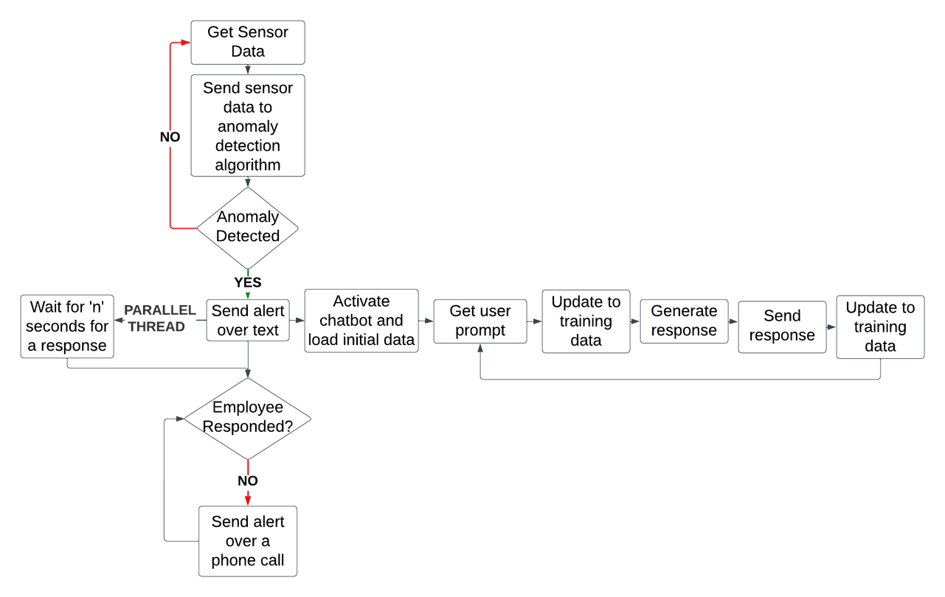
TEAM VISIONARIES
TECHNICAL APPROACH
The project will utilize machine learning algorithms to detect anomalies in smoke sensor data. When an anomaly is identified, the chatbot interface will immediately notify maintenance personnel. If there's no response, the chatbot will initiate a voice call. Once connected, the chatbot will provide instructions to address the anomaly, ensuring swift resolution of issues and seamless communication in industrial settings.

Slide 10


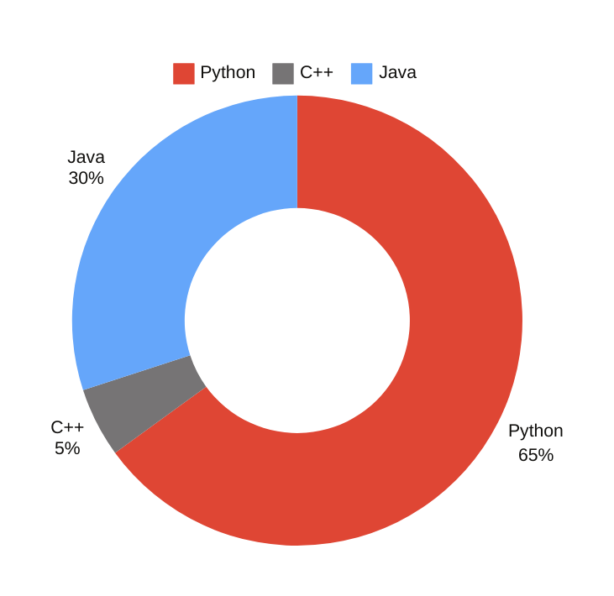
TOOLS AND LANGUAGES
Programming Languages:
Arduino & Hardware Interface:
Python and C++ for general and system programming respectively.
Program Arduino for hardware control and interface with sensors and actuators.
Server Connection & Client Development:
Technologies & Tools:
Use Electron for cross-platform desktop apps, utilize Websockets for real-time messaging, and implement RESTful APIs for managing data.
Develop server connections and client-side integration for PC to Android, incorporating Twilio APIs for server-side communication.
Machine Learning & AI:
Frameworks & Libraries:
Utilize machine learning and AI techniques to develop a chatbot and implement an anomaly detection algorithm.
Utilize React.js for UI, employ Node.js and Flask/Django for backend, and implement TensorFlow for neural networks.ed.

Slide 11
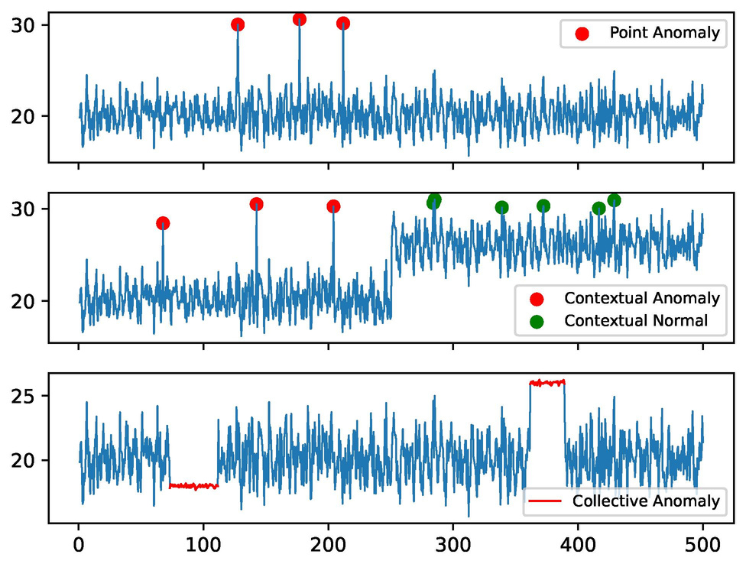
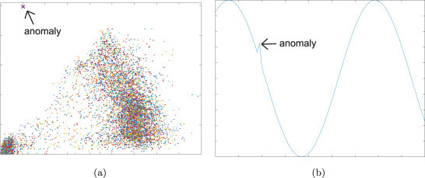
TEAM VISIONARIES
The red points in the data are an indication of any abnormalities detected by the sensor. These anomalies can be identified by their deviation from the usual or expected data patterns. By observing these red points, we can identify any potential issues or irregularities in the data that require further attention or investigation.
NOTES:

Slide 12

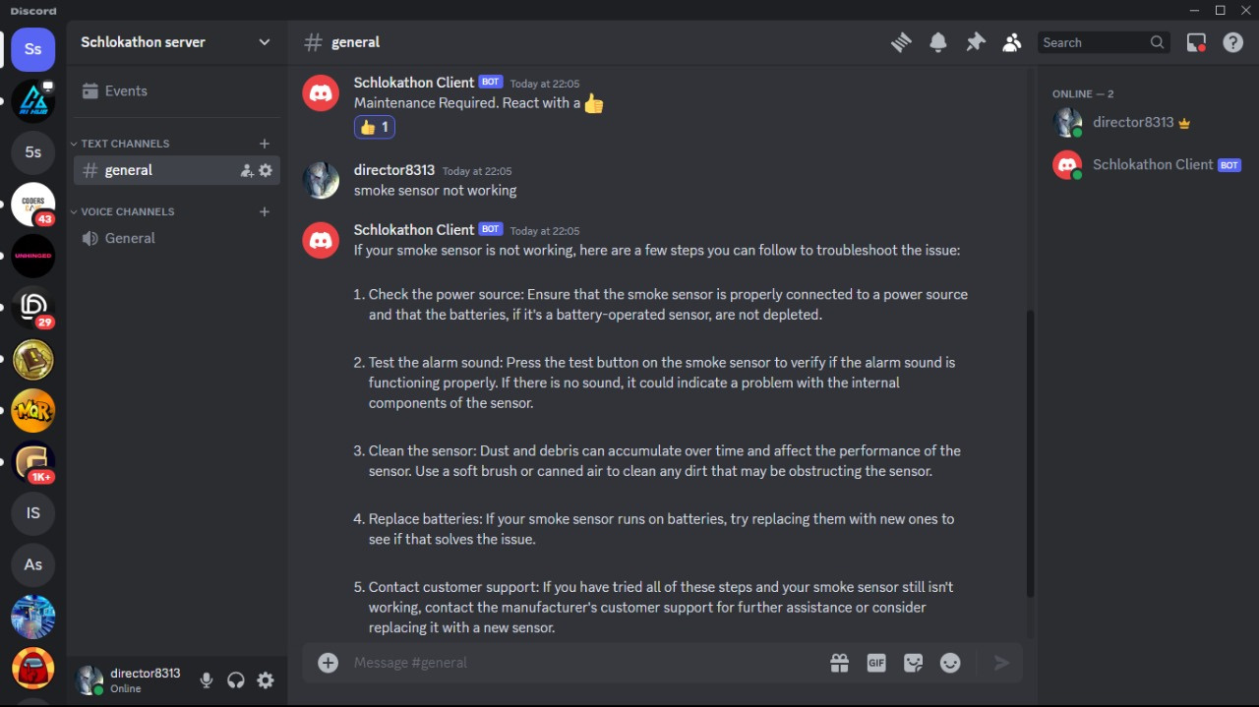
TEAM VISIONARIES
SAMPLE UI/UX DESIGN

Slide 13


TEAM VISIONARIES
IMPLEMENTATION
ANOMALY DETECTION MODEL
A sensor data-based anomaly detection model will be developed as the first step.
SHORT TERM
CHATBOT
A chatbot will be developed using LLM models to provide accurate and precise instructions.
INTERFACE CREATION
A client application will be created and added to an already existing server that is compatible with multiple platforms.

Slide 14
TEAM VISIONARIES
LONG TERM
Step 1
Step 2
Step 3
MOBILE APP IMPLEMENTATION
INDUSTRY IMPLEMENTATION
COMMERICAL IMPLEMENTATION

Slide 15
TEAM VISIONARIES
IMPACT AND BENEFITS
Proactive Hazard Mitigation: By leveraging machine learning algorithms to detect anomalies in smoke sensor data, the system enables proactive identification of potential safety hazards, such as fires or gas leaks, allowing for swift intervention to prevent accidents and ensure the safety of workers and assets.
Minimized Downtime and Maintenance Costs: Through timely detection of anomalies and automated communication via the chatbot interface, maintenance personnel can promptly address issues before they escalate into major failures, minimizing unplanned downtime and reducing emergency repair costs, leading to improved operational efficiency and cost savings.
Streamlined Communication and Response: The integration of a chatbot interface facilitates seamless communication between maintenance personnel and the predictive maintenance system, providing instant alerts, actionable recommendations, and real-time support, thereby enhancing response times, productivity, and decision-making in industrial environments.

Slide 16
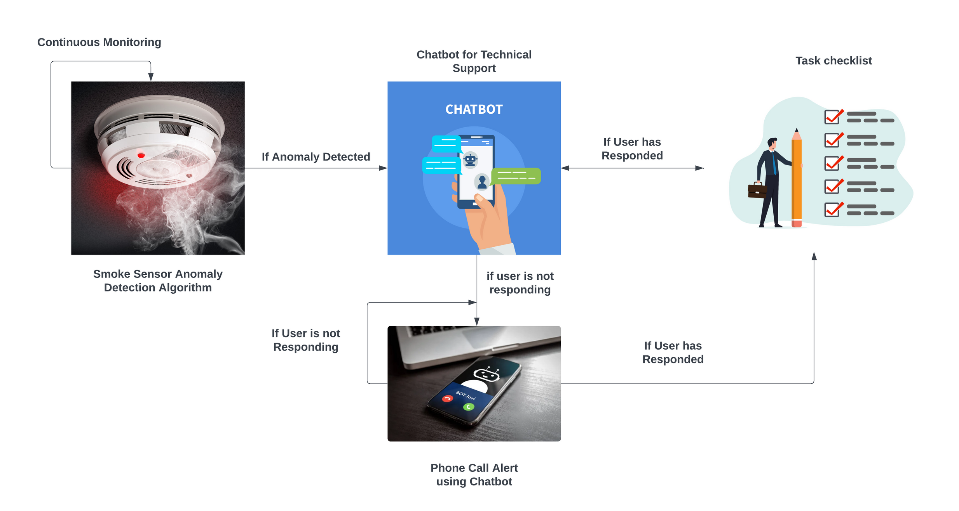

Slide 17


TEAM VISIONARIES
CONCLUSION
In conclusion, implementing a predictive maintenance system integrated with a chatbot interface for smoke sensors in industrial environments offers significant advantages. It enhances safety by proactively identifying hazards, reduces downtime and costs through timely anomaly detection, and improves overall efficiency by streamlining communication and response processes. By leveraging advanced technologies and fostering proactive maintenance practices, organizations can achieve greater operational resilience and optimize resource utilization, ultimately driving towards safer, more efficient industrial operations.

Slide 18

THANK YOU
TEAM VISIONARIES

